Slide 1

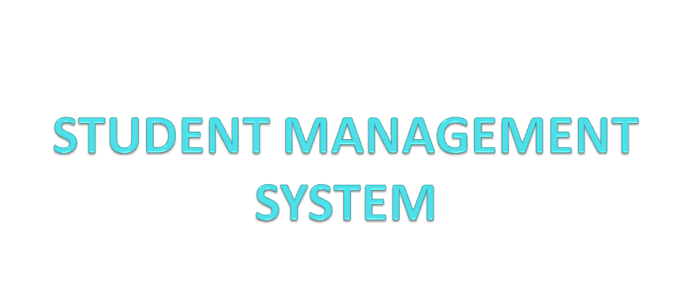

Slide 2
Guided By: Presented By:
Mrs.Shilpi Khanna Prashant Upadhyay

Slide 3
ABSTRACT
  OBJECTIVE:
Student Management System is software which is helpful for college as well as the school authorities. In the current system all the activities are done manually. It is very time consuming and costly. Our Student Management System deals with the various activities related to managing student records. Our Objective is computerizing the process of student records management.
Notes:
3

Slide 4
MODULES
ADD NEW STUDENT RECORD
UPDATE EXISTING STUDENT RECORD
DELETE STUDENT RECORD
SEARCH STUDENT RECORD BY ROLL N0.,Name…

Slide 5

FRONTEND (LANGUAGE USED)
PYTHON (Tkinter)

Slide 6

BACKEND
MYSQL (DATABASE)

Slide 7
SOFTWARE USED
PYTHON INTERPRETER
PYCHARM IDE
NOTEPAD++

Slide 8
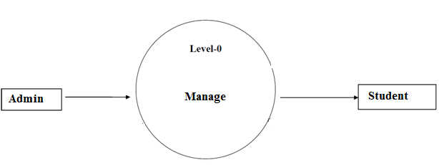
DFD(DATA FLOW DIAGRAM)
Level - 0

Slide 9
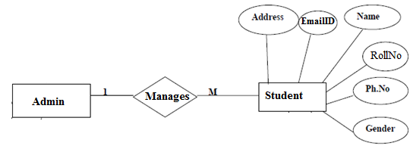
ER DIAGRAM

Slide 10
USE CASE DIAGRAM
Use case diagram consists of use cases and actors and shows the interaction between them. The key points are:
The main purpose is to show the interaction between the use cases and the actor.
To represent the system requirement from user’s perspective.
The use cases are the functions that are to be performed in the module.
An actor could be the end-user of the system or an external system.

Slide 11
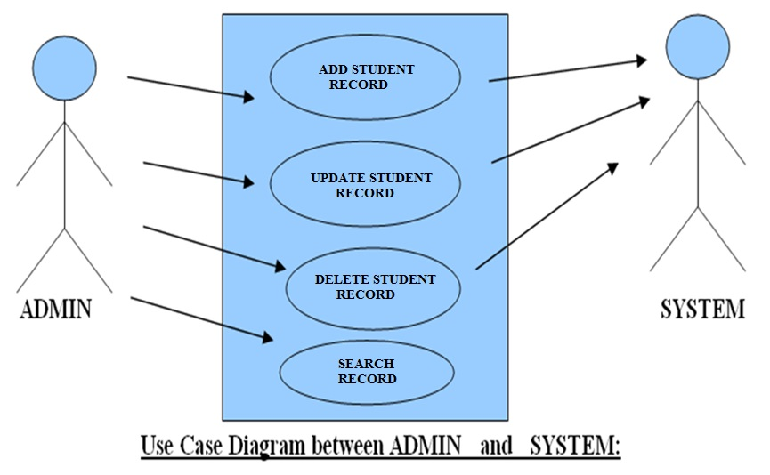
USE CASE DIAGRAM

Slide 12
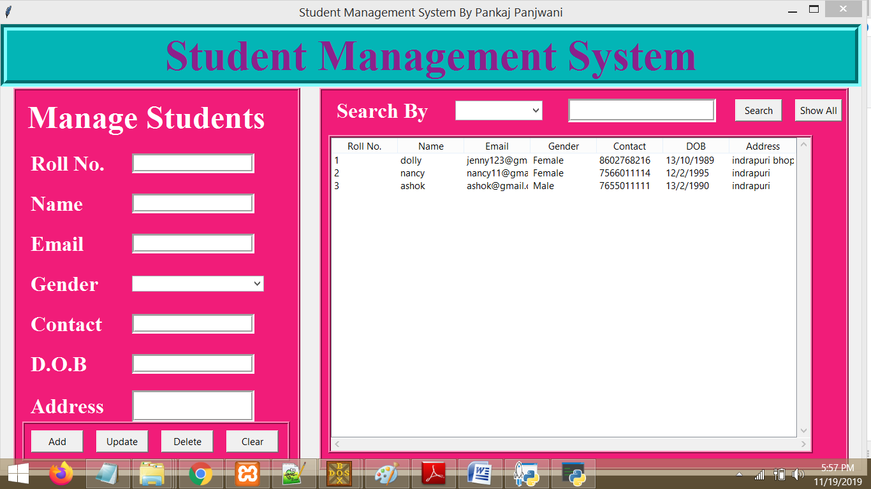
ScreenShot

Slide 13
FUTURE SCOPE
FUTURE SCOPE
This Software can be made for all OS
Higher Security features can be included in this software.
Program scheduling can also be included in this software.
This software can be developed to use as tutorial to teach basic concepts of OS to new users.
This system can be implemented with OS to reduce overhead of installing and running interface of each and every tool at different place.
Automatic Shutdown through SMS service can be implemented in this.

Slide 14
CONCLUSION
The project entitled “Student Management System” is developed using Python Tkinter as front end and MYSQL database in back end to computerize the process of management of student records. This project covers only the basic features required.

Slide 15
BIBLIOGRAPHY
FOR PYTHON INSTALLATION
https://www.python.org
FOR PYTHON TKINTER BASICS
www.w3schools.com
www.javatpoint.com

Slide 16
THANKYOU

